Slide 1
CSC3-I: Secure Configurations For HW & SW

Slide 2
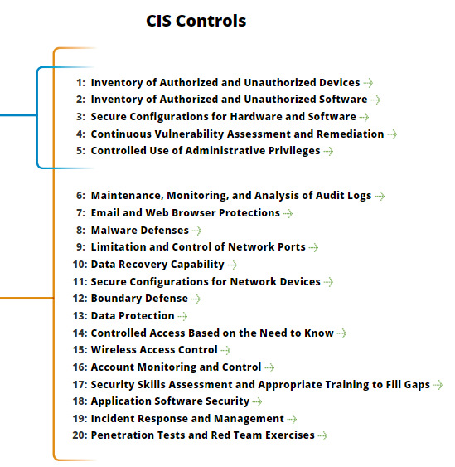
CSC3-I: Secure Configurations For HW & SW
https://www.cisecurity.org/controls/

Slide 3
CSC3-I: Secure Configurations For HW & SW
3.1 Establish standard secure configurations of your operating systems and software applications.
Standardized images should represent hardened versions of the underlying operating system and the applications installed on the system.

Slide 4
CSC3-I: Secure Configurations For HW & SW
3.1…: These images should be validated and refreshed on a regular basis to update their security configuration in light of recent vulnerabilities and attack vectors.

Slide 5
CSC3-I: Secure Configurations For HW & SW
3.2: Follow strict configuration management, building a secure image that is used to build all new systems that are deployed in the enterprise.
Any existing system that becomes compromised should be re-imaged with the secure build.

Slide 6
CSC3-I: Secure Configurations For HW & SW
3.2: Regular updates or exceptions to this image should be integrated into the organization’s change management processes.
Images should be created for workstations, servers, and other system types used by the organization.

Slide 7
CSC3-I: Secure Configurations For HW & SW
3.3: Store the master images on securely configured servers, validated with integrity checking tools capable of continuous inspection, and change management to ensure that only authorized changes to the images are possible.

Slide 8
CSC3-I: Secure Configurations For HW & SW
3.3…: Alternatively, these master images can be stored in offline machines, air-gapped from the production network, with images copied via secure media to move them between the image storage servers and the production network.

Slide 9
CSC3-I: Secure Configurations For HW & SW
3.4: Perform all remote administration of servers, workstation, network devices, and similar equipment over secure channels.

Slide 10
CSC3-I: Secure Configurations For HW & SW
3.4…: Protocols such as telnet, VNC, RDP, or others that do not actively support strong encryption should only be used if they are performed over a secondary encryption channel, such as SSL, TLS or IPSEC.
END

